Slide 1
Computer Organization
CS1403
Arithmetic for Computers

Slide 2
Arithmetic for Computers
Operations on integers
Addition and subtraction
Multiplication and division
Dealing with overflow
Floating-point real numbers
Representation and operations

Slide 3
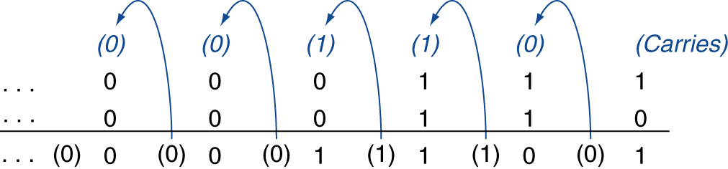
Integer Addition
Example: 7 + 6
Overflow if result out of range
Adding +ve and –ve operands, no overflow
Adding two +ve operands
Overflow if result sign is 1
Adding two –ve operands
Overflow if result sign is 0

Slide 4
Integer Subtraction
Add negation of second operand
Example: 7 – 6 = 7 + (–6)
+7: 0000 0000 … 0000 0111 –6: 1111 1111 … 1111 1010 +1: 0000 0000 … 0000 0001
Overflow if result out of range
Subtracting two +ve or two –ve operands, no overflow
Subtracting +ve from –ve operand
Overflow if result sign is 0
Subtracting –ve from +ve operand
Overflow if result sign is 1

Slide 5
Dealing with Overflow
Some languages (e.g., C) ignore overflow
Use MIPS addu, addui, subu instructions
Other languages (e.g., Ada, Fortran) require raising an exception
Use MIPS add, addi, sub instructions
On overflow, invoke exception handler
Save PC in exception program counter (EPC) register
Jump to predefined handler address
mfc0 (move from coprocessor reg) instruction can retrieve EPC value, to return after corrective action

Slide 6
ALU (Building Blocks)

Slide 7
A Simple Multi-Function Logic Unit
To warm up let's build a logic unit to support the and and or instructions for MIPS (32-bit registers)
we'll just build a 1-bit unit and use 32 of them
Possible implementation using a multiplexor :
operation
selector
a
output
b

Slide 8
Implementation with a Multiplexor
Selects one of the inputs to be the output
based on a control input
Lets build our ALU using a MUX (multiplexor):
.
.
.
32 units

Slide 9
Implementations
Let's look at a 1-bit ALU for addition:
How could we build a 1-bit ALU for add, and, and or?
How could we build a 32-bit ALU?
c_{out} = a.b + a.c_{in} + b.c_{in}
sum = a.b.c_{in} + a.b.c_{in} +
a.b.c_{in} + a.b.c_{in}
= a ⊕ b ⊕ c_{in}
exclusive or (xor)

Slide 10
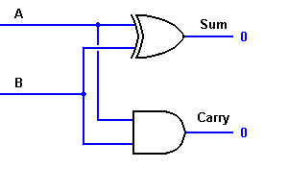
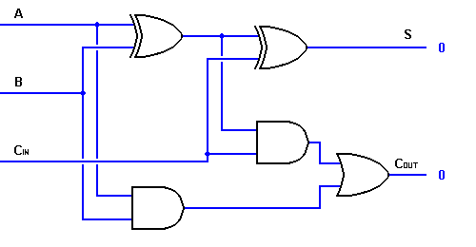
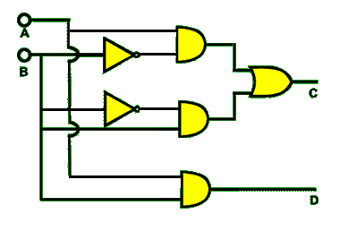
1-bit Adder Logic
xor
Half-adder with one xor gate
Full-adder from 2 half-adders and
an or gate
Half-adder with the xor gate replaced
by primitive gates using the equation
A⊕B = A.B +A.B

Slide 11
Building a 32-bit ALU
Multiplexor control line
1-bit ALU for AND, OR and add
Ripple-Carry Logic for 32-bit ALU

Slide 12
What about Subtraction (a – b) ?
Two's complement approach: just negate b and add.
How do we negate?
recall negation shortcut : invert each bit of b and set CarryIn to least significant bit (ALU0) to 1

Slide 13
Problem: Ripple-carry Adder is Slow
Is a 32-bit ALU as fast as a 1-bit ALU? Why?
Is there more than one way to do addition? Yes:
one extreme: ripple-carry – carry ripples through 32 ALUs, slow!
other extreme: sum-of-products for each CarryIn bit – super fast!
CarryIn bits:
c₁ = b₀.c₀ + a₀.c₀ + a₀.b₀
c₂ = b₁.c₁ + a₁.c₁ + a₁.b₁
= a₁.a₀.b₀ + a₁.a₀.c₀ + a₁.b₀.c₀ (substituting for c₁)
+ b₁.a₀.b₀ + b₁.a₀.c₀ + b₁.b₀.c₀ + a₁.b₁
c₃ = b₂.c₂ + a₂.c₂ + a₂.b₂
= … = sum of 15 4-term products…
How fast? But not feasible for a 32-bit ALU! Why? Exponential complexity!!
Note: c_{i} is CarryIn bit into i th ALU;
c₀ is the forced CarryIn into the
least significant ALU

Slide 14
Two-level Carry-lookahead Adder: First Level
An approach between our two extremes
Motivation:
if we didn't know the value of a carry-in, what could we do?
when would we always generate a carry? (generate) g_{i} = a_{i} . b_{i}
when would we propagate the carry? (propagate) p_{i} = a_{i} + b_{i}
Express (carry-in equations in terms of generate/propagates)
c₁ = g₀ + p₀.c₀
c₂ = g₁ + p₁.c₁ = g₁ + p₁.g₀ + p₁.p₀.c₀
c₃ = g₂ + p₂.c₂ = g₂ + p₂.g₁ + p₂.p₁.g₀ + p₂.p₁.p₀.c₀
c₄ = g₃ + p₃.c₃ = g₃ + p₃.g₂ + p₃.p₂.g₁ + p₃.p₂.p₁.g₀
+ p₃.p₂.p₁.p₀.c₀
Feasible for 4-bit adders – with wider adders unacceptable complexity.
solution: build a first level using 4-bit adders, then a second level on top
Or ripple it after 4 bits

Slide 15
Two-level Carry-look-ahead Adder: Second Level for a 16-bit adder
Propagate signals for each of the four 4-bit adder blocks:
P₀ = p₃.p₂.p₁.p₀
P₁ = p₇.p₆.p₅.p₄
P₂ = p₁₁.p₁₀.p₉.p₈
P₃ = p₁₅.p₁₄.p₁₃.p₁₂
Generate signals for each of the four 4-bit adder blocks:
G₀ = g₃ + p₃.g₂ + p₃.p₂.g₁ + p₃.p₂.p₁.g₀
G₁ = g₇ + p₇.g₆ + p₇.p₆.g₅ + p₇.p₆.p₅.g₄
G₂ = g₁₁ + p₁₁.g₁₀ + p₁₁.p₁₀.g₉ + p₁₁.p₁₀.p₉.g₈
G₃ = g₁₅ + p₁₅.g₁₄ + p₁₅.p₁₄.g₁₃ + p₁₅.p₁₄.p₁₃.g₁₂

Slide 16
Two-level Carry-look-ahead Adder: Second Level for a 16-bit adder
CarryIn signals for each of the four 4-bit adder blocks (see earlier carry-in equations in terms of generate/propagates):
C₁ = G₀ + P₀.c₀
C₂ = G₁ + P₁.G₀ + P₁.P₀.c₀
C₃ = G₂ + P₂.G₁ + P₂.P₁.G₀ + P₂.P₁.P₀.c₀
C₄ = G₃ + P₃.G₂ + P₃.P₂.G₁ + P₃.P₂.P₁.G₀ + P₃.P₂.P₁.P₀.c₀

Slide 17
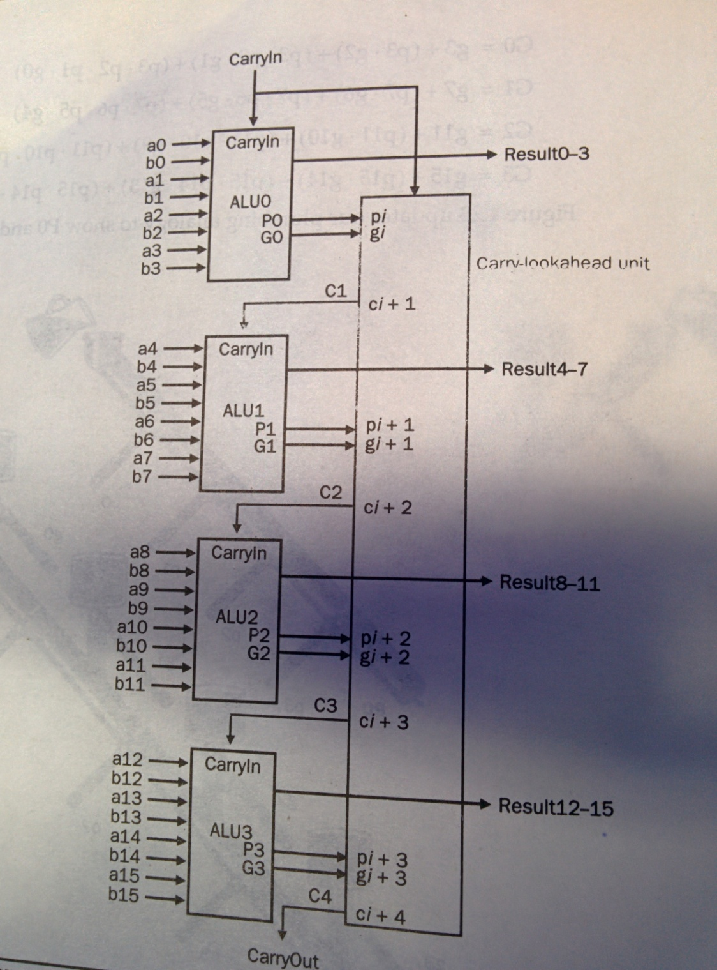

Slide 18
Two-level Carry-look-ahead Adder: Second Level for a 16-bit adder
Two-level carry-lookahead logic steps:
compute p_{i}’s and g_{i}’s at each 1-bit ALU
compute P_{i}’s and G_{i}’s at each 4-bit adder unit
compute C_{i}’s in carry-lookahead unit
compute c_{i}’s at each 4-bit adder unit
compute results (sum bits) at each 1-bit ALU
E.g., add using carry-lookahead logic:
0001 1010 0011 0011
1110 0101 1110 1011
Compare times for ripple-carry vs. carry-lookahead for a 16-bit adder assuming unit delay at each gate

Slide 19
Carry Look Ahead
C0 = Cin
A B C-out
0 0 0 “kill”
0 1 C-in “propagate”
1 0 C-in “propagate”
1 1 1 “generate”
A0
S
G
B0
P
C1 = G0 + C0 • P0
A1
S
G = A and B
P = A or B
G
B1
P
C2 = G1 + G0 • P1 + C0 • P0 • P1
A2
S
G
B2
P
C3 = G2 + G1 • P2 + G0 • P1 • P2 + C0 • P0 • P1 • P2
A3
S
G
G
B3
P
P
C4 = . . .

Slide 20
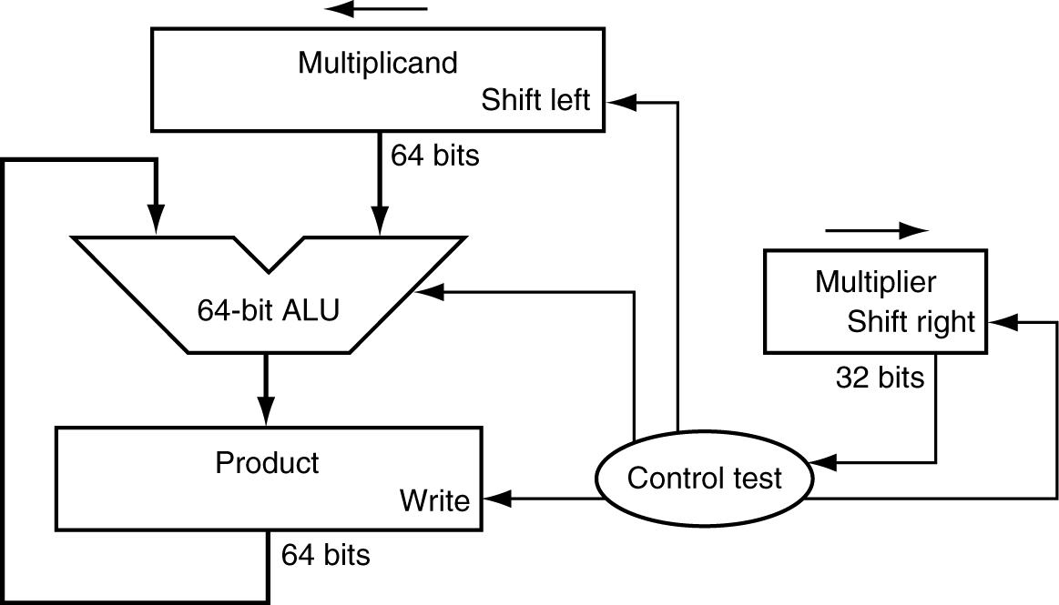
Multiplication
Start with long-multiplication approach
multiplicand
1000
× 1001
1000
0000
0000
1000
1001000
multiplier
product
Length of product is the sum of operand lengths

Slide 21
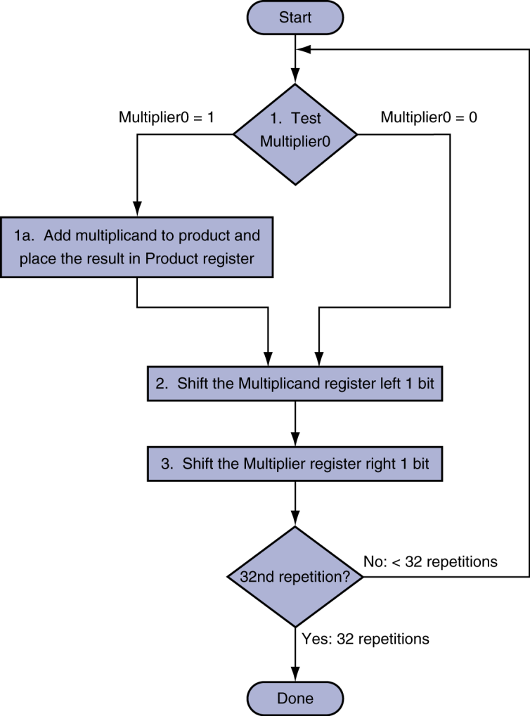
Multiplication Hardware
Initially 0

Slide 22
Unsigned shift-add multiplier (version 1)
64-bit Multiplicand reg, 64-bit ALU, 64-bit Product reg, 32-bit multiplier reg
Shift Left
Multiplicand
64 bits
Multiplier
Shift Right
64-bit ALU
32 bits
Product
Write
Control
64 bits
Multiplier = datapath + control

Slide 23
Multiply Algorithm Version 1
Start
Multiplier0 = 1
1.
Multiplier0 = 0
Test
Multiplier0
1a. Add multiplicand to product &
place the result in Product register
Product Multiplier Multiplicand 0000 0000 0011 0000 0010
0000 0010 0001 0000 0100
0000 0110 0000 0000 1000
0000 0110
2. Shift the Multiplicand register left 1 bit.
3. Shift the Multiplier register right 1 bit.
32nd
repetition?
No: < 32 repetitions
Yes: 32 repetitions
Done
Notes:
M’ier: 0011 M’and: 0000 0010 P: 0000 0000
1a. 1=>P=P+Mcand M’ier: 0011 Mcand: 0000 0010 P: 0000 0010
2. Shl Mcand M’ier: 0011 Mcand: 0000 0100 P: 0000 0010
3. Shr M’ier M’ier: 0001 Mcand: 0000 0100 P: 0000 0010
1a. 1=>P=P+Mcand M’ier: 0001 Mcand: 0000 0100 P: 0000 0110
2. Shl Mcand M’ier: 0001 Mcand: 0000 1000 P: 0000 0110
3. Shr M’ier M’ier: 0000 Mcand: 0000 1000 P: 0000 0110
1. 0=>nop M’ier: 0000 Mcand: 0000 1000 P: 0000 0110
2. Shl Mcand M’ier: 0000 Mcand: 0001 0000 P: 0000 0110
3. Shr M’ier M’ier: 0000 Mcand: 0001 0000 P: 0000 0110
1. 0=>nop M’ier: 0000 Mcand: 0001 0000 P: 0000 0110
2. Shl Mcand M’ier: 0000 Mcand: 0010 0000 P: 0000 0110
3. Shr M’ier M’ier: 0000 Mcand: 0010 0000 P: 0000 0110

Slide 24
Observations on Multiply Version 1
1 clock per cycle => ≈ 100 clocks per multiply
Ratio of multiply to add 5:1 to 100:1
1/2 bits in multiplicand always 0 => 64-bit adder is wasted
0’s inserted in right of multiplicand as shifted => least significant bits of product never changed once formed
Instead of shifting multiplicand to left, shift product to right?
Notes:
Addition and subtraction may be anywhere from 5 to 100 times more popular than multiply. But according to Amdahl’s law, even a moderate frequency for a a slow operation can limit performance.

Slide 25
MULTIPLY HARDWARE Version 2
32-bit Multiplicand reg, 32 -bit ALU, 64-bit Product reg, 32-bit Multiplier reg
Multiplicand
32 bits
Multiplier
Shift Right
32-bit ALU
32 bits
Shift Right
Product
Control
64 bits
Write

Slide 26
Multiply Algorithm Version 2
Start
Multiplier0 = 1
1.
Multiplier0 = 0
Test
Multiplier0
1a. Add multiplicand to the left half of product &
place the result in the left half of Product register
Product Multiplier Multiplicand
0000 0000 0011 0010
1: 0010 0000 0011 0010
2: 0001 0000 0011 0010
3: 0001 0000 0001 0010
1: 0011 0000 0001 0010
2: 0001 1000 0001 0010
3: 0001 1000 0000 0010
1: 0001 1000 0000 0010
2: 0000 1100 0000 0010
3: 0000 1100 0000 0010
1: 0000 1100 0000 0010
2: 0000 0110 0000 0010
3: 0000 0110 0000 0010
0000 0110 0000 0010
2. Shift the Product register right 1 bit.
3. Shift the Multiplier register right 1 bit.
32nd
repetition?
No: < 32 repetitions
Yes: 32 repetitions
Done
Notes:
M’ier: 0011 Mcand: 0010 P: 0000 0000
1a. 1=>P=P+Mcand M’ier: 0011 Mcand: 0010 P: 0010 0000
2. Shr P M’ier: 0011 Mcand: 0010 P: 0001 0000
3. Shr M’ier M’ier: 0001 Mcand: 0010 P: 0001 0000
1a. 1=>P=P+Mcand M’ier: 0001 Mcand: 0010 P: 0011 0000
2. Shr P M’ier: 0001 Mcand: 0010 P: 0001 1000
3. Shr M’ier M’ier: 0000 Mcand: 0010 P: 0001 1000
1. 0=>nop M’ier: 0000 Mcand: 0010 P: 0001 1000
2. Shr P M’ier: 0000 Mcand: 0010 P: 0000 1100
3. Shr M’ier M’ier: 0000 Mcand: 0010 P: 0000 1100
1. 0=>nop M’ier: 0000 Mcand: 0010 P: 0000 1100
2. Shr P M’ier: 0000 Mcand: 0010 P: 0000 0110
3. Shr M’ier M’ier: 0000 Mcand: 0010 P: 0000 0110

Slide 27
Still more wasted space!
Start
Multiplier0 = 1
1.
Multiplier0 = 0
Test
Multiplier0
1a. Add multiplicand to the left half of product &
place the result in the left half of Product register
Product Multiplier Multiplicand
0000 0000 0011 0010
1: 0010 0000 0011 0010
2: 0001 0000 0011 0010
3: 0001 0000 0001 0010
1: 0011 0000 0001 0010
2: 0001 1000 0001 0010
3: 0001 1000 0000 0010
1: 0001 1000 0000 0010
2: 0000 1100 0000 0010
3: 0000 1100 0000 0010
1: 0000 1100 0000 0010
2: 0000 0110 0000 0010
3: 0000 0110 0000 0010
0000 0110 0000 0010
2. Shift the Product register right 1 bit.
3. Shift the Multiplier register right 1 bit.
32nd
repetition?
No: < 32 repetitions
Yes: 32 repetitions
Done
Notes:
M’ier: 0011 Mcand: 0010 P: 0000 0000
1a. 1=>P=P+Mcand M’ier: 0011 Mcand: 0010 P: 0010 0000
2. Shr P M’ier: 0011 Mcand: 0010 P: 0001 0000
3. Shr M’ier M’ier: 0001 Mcand: 0010 P: 0001 0000
1a. 1=>P=P+Mcand M’ier: 0001 Mcand: 0010 P: 0011 0000
2. Shr P M’ier: 0001 Mcand: 0010 P: 0001 1000
3. Shr M’ier M’ier: 0000 Mcand: 0010 P: 0001 1000
1. 0=>nop M’ier: 0000 Mcand: 0010 P: 0001 1000
2. Shr P M’ier: 0000 Mcand: 0010 P: 0000 1100
3. Shr M’ier M’ier: 0000 Mcand: 0010 P: 0000 1100
1. 0=>nop M’ier: 0000 Mcand: 0010 P: 0000 1100
2. Shr P M’ier: 0000 Mcand: 0010 P: 0000 0110
3. Shr M’ier M’ier: 0000 Mcand: 0010 P: 0000 0110

Slide 28
Observations on Multiply Version 2
Product register wastes space that exactly matches size of multiplier => combine Multiplier register and Product register

Slide 29
MULTIPLY HARDWARE Version 3
32-bit Multiplicand reg, 32 -bit ALU, 64-bit Product reg, (0-bit Multiplier reg)
Multiplicand
32 bits
32-bit ALU
Shift Right
Product
(Multiplier)
Control
64 bits
Write

Slide 30
Multiply Algorithm Version 3
Start
Product0 = 1
Multiplicand Product 0010 0000 0011
1.
Test
Product0 = 0
Product0
1a. Add multiplicand to the left half of product &
place the result in the left half of Product register
2. Shift the Product register right 1 bit.
32nd
repetition?
No: < 32 repetitions
Yes: 32 repetitions
Done
Notes:
Mcand: 0010 P: 0000 0011
1a. 1=>P=P+Mcand Mcand: 0010 P: 0010 0011
2. Shr P Mcand: 0010 P: 0001 0001
1a. 1=>P=P+Mcand Mcand: 0010 P: 0011 0001
2. Shr P Mcand: 0010 P: 0001 1000
1. 0=>nop Mcand: 0010 P: 0001 1000
2. Shr P Mcand: 0010 P: 0000 1100
1. 0=>nop Mcand: 0010 P: 0000 1100
2. Shr P Mcand: 0010 P: 0000 0110

Slide 31
Observations on Multiply Version 3
2 steps per bit because Multiplier & Product combined
MIPS registers Hi and Lo are left and right half of Product
Gives us MIPS instruction MultU
How can you make it faster?
What about signed multiplication?
easiest solution is to make both positive & remember whether to complement product when done (leave out the sign bit, run for 31 steps)
apply definition of 2’s complement
need to sign-extend partial products and subtract at the end
Booth’s Algorithm is elegant way to multiply signed numbers using same hardware as before and save cycles
can handle multiple bits at a time

Slide 32
Motivation for Booth’s Algorithm
Example 2 x 6 = 0010 x 0110: 0010 x 0110 + 0000 shift (0 in multiplier) + 0010 add (1 in multiplier) + 0010 add (1 in multiplier) + 0000 shift (0 in multiplier) 00001100
ALU with add or subtract gets same result in more than one way: 6 = – 2 + 8 0110 = – 00010 + 01000 = 11110 + 01000
For example
0010 x 0110 0000 shift (0 in multiplier) – 0010 sub (first 1 in multpl.) . 0000 shift (mid string of 1s) . + 0010 add (prior step had last1) 00001100

Slide 33
Booth’s Algorithm
end of run
middle of run
beginning of run
0 1 1 1 1 0
Current Bit Bit to the Right Explanation Example Op
1 0 Begins run of 1s 0001111000 sub
1 1 Middle of run of 1s 0001111000 none
0 1 End of run of 1s 0001111000 add
0 0 Middle of run of 0s 0001111000 none
Originally for Speed (when shift was faster than add)
Replace a string of 1s in multiplier with an initial subtract when we first see a one and then later add for the bit after the last one
–1
+ 10000
01111

Slide 34
Booths Example (2 x 7)
Operation Multiplicand Product next?
0. initial value 0010 0000 0111 0 10 -> sub
1a. P = P - m 1110 + 1110 1110 0111 0 shift P (sign ext)
1b. 0010 1111 0011 1 11 -> nop, shift
2. 0010 1111 1001 1 11 -> nop, shift
3. 0010 1111 1100 1 01 -> add
4a. 0010 + 0010
0001 1100 1 shift
4b. 0010 0000 1110 0 done

Slide 35
Booths Example (2 x -3)
Operation Multiplicand Product next?
0. initial value 0010 0000 1101 0 10 -> sub
1a. P = P - m 1110 + 1110 1110 1101 0 shift P (sign ext)
1b. 0010 1111 0110 1 01 -> add + 0010
2a. 0001 0110 1 shift P
2b. 0010 0000 1011 0 10 -> sub + 1110
3a. 0010 1110 1011 0 shift
3b. 0010 1111 0101 1 11 -> nop
4a 1111 0101 1 shift
4b. 0010 1111 1010 1 done

Slide 36
Division
Check for 0 divisor
Long division approach
If divisor ≤ dividend bits
1 bit in quotient, subtract
Otherwise
0 bit in quotient, bring down next dividend bit
Restoring division
Do the subtract, and if remainder goes < 0, add divisor back
Signed division
Divide using absolute values
Adjust sign of quotient and remainder as required
quotient
dividend
1001
1000 1001010
-1000
10
101
1010
-1000
10
divisor
remainder
n-bit operands yield n-bit quotient and remainder

Slide 37
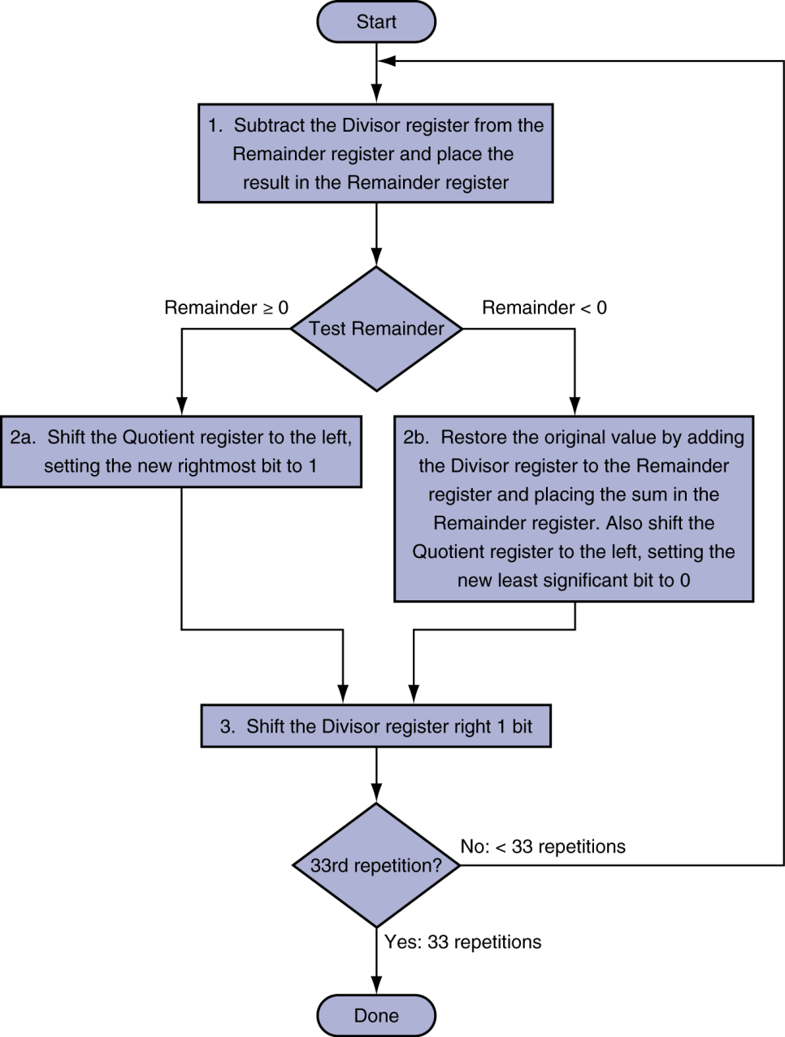
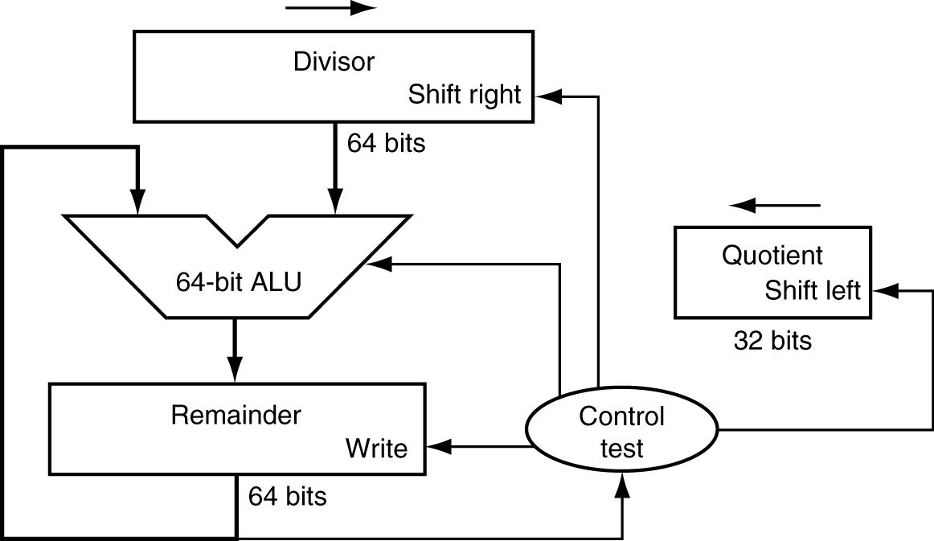
Division Hardware
Initially divisor in left half
Initially dividend

Slide 38
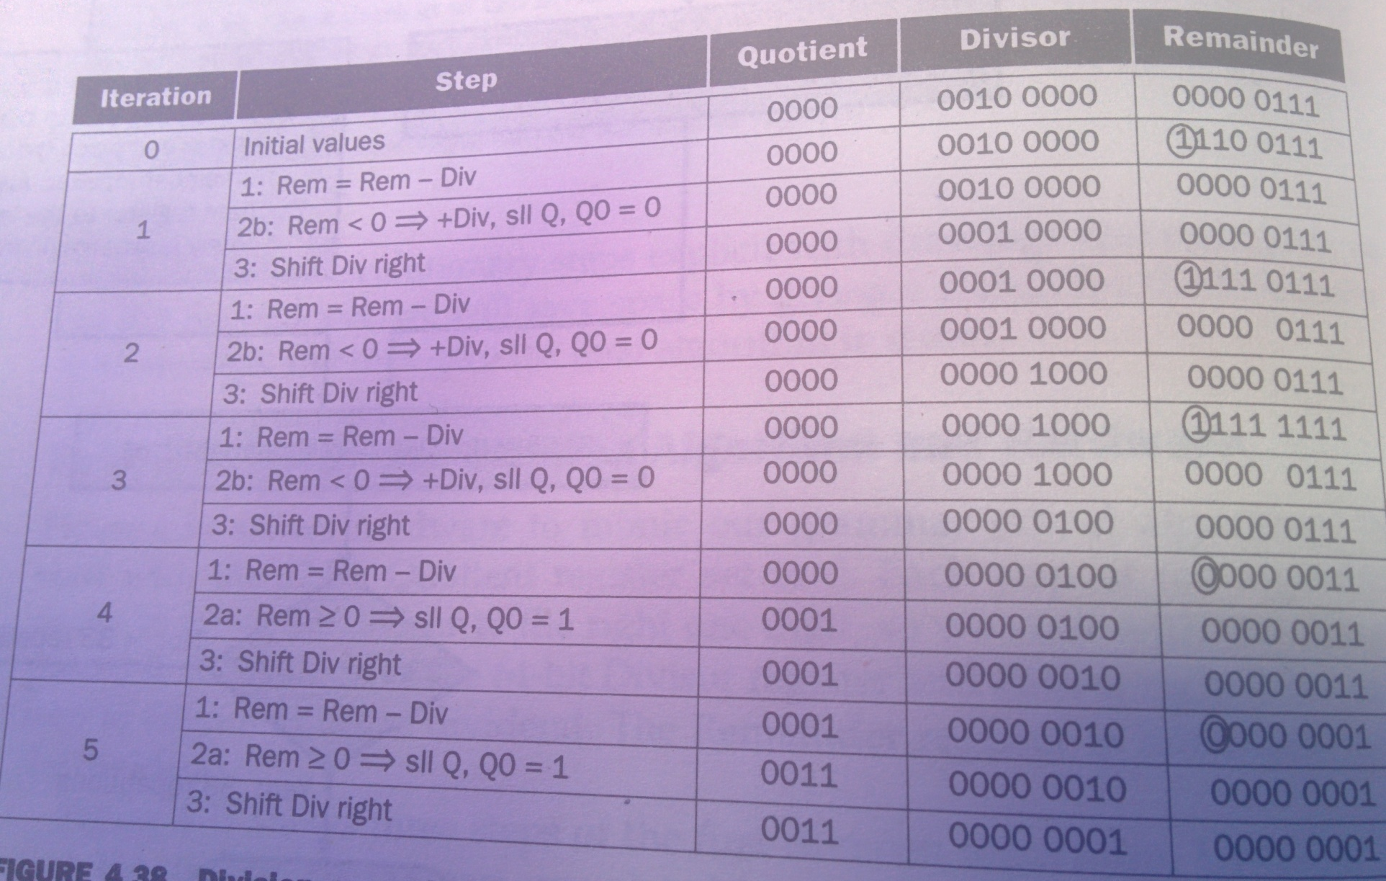
Example

Slide 39
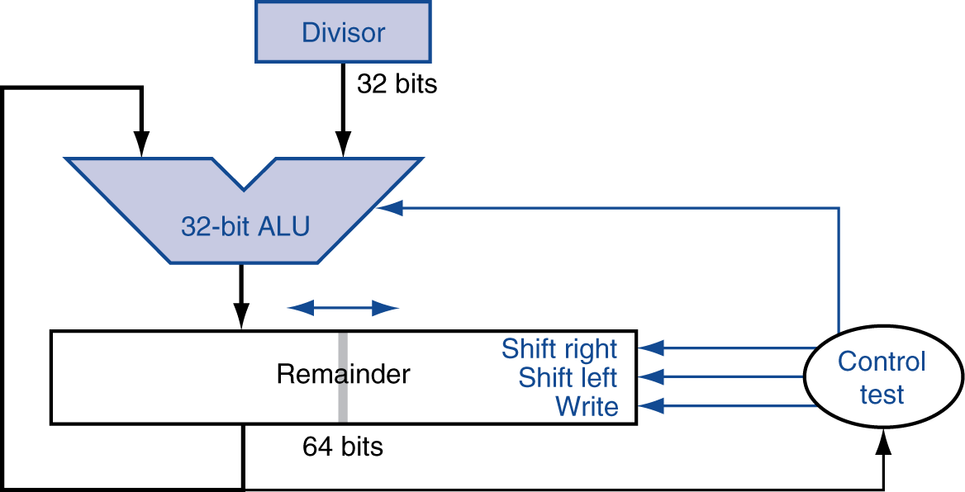
Optimized Divider
One cycle per partial-remainder subtraction
Looks a lot like a multiplier!
Same hardware can be used for both

Slide 40
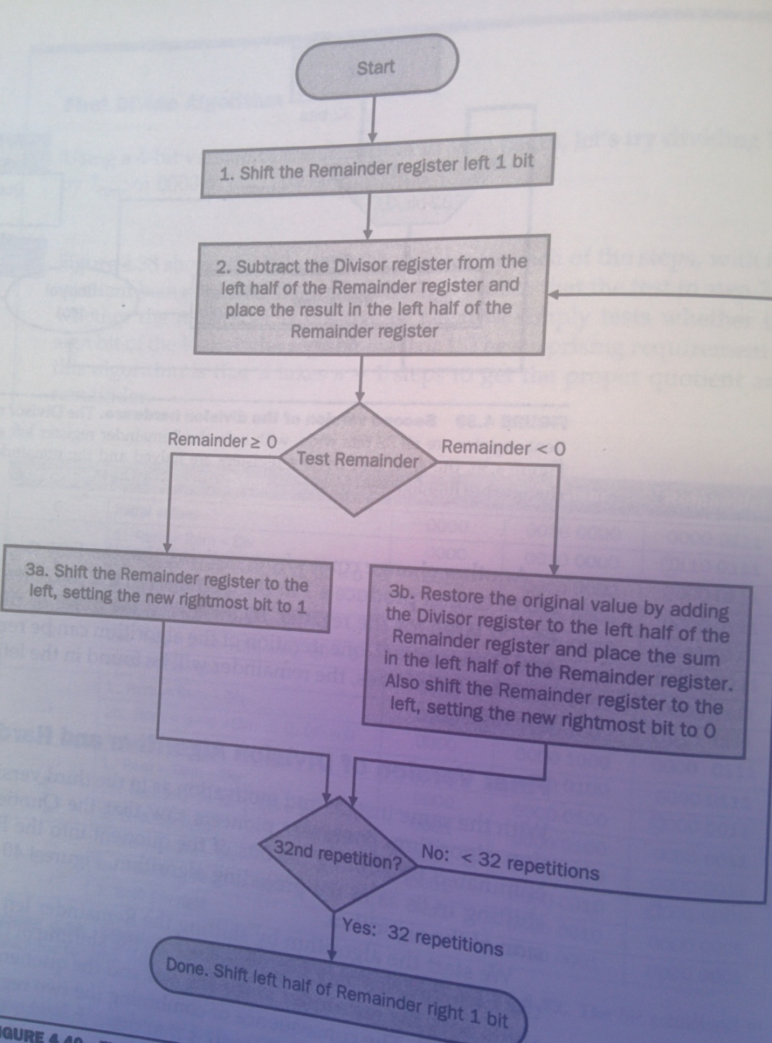
Algorithm

Slide 41
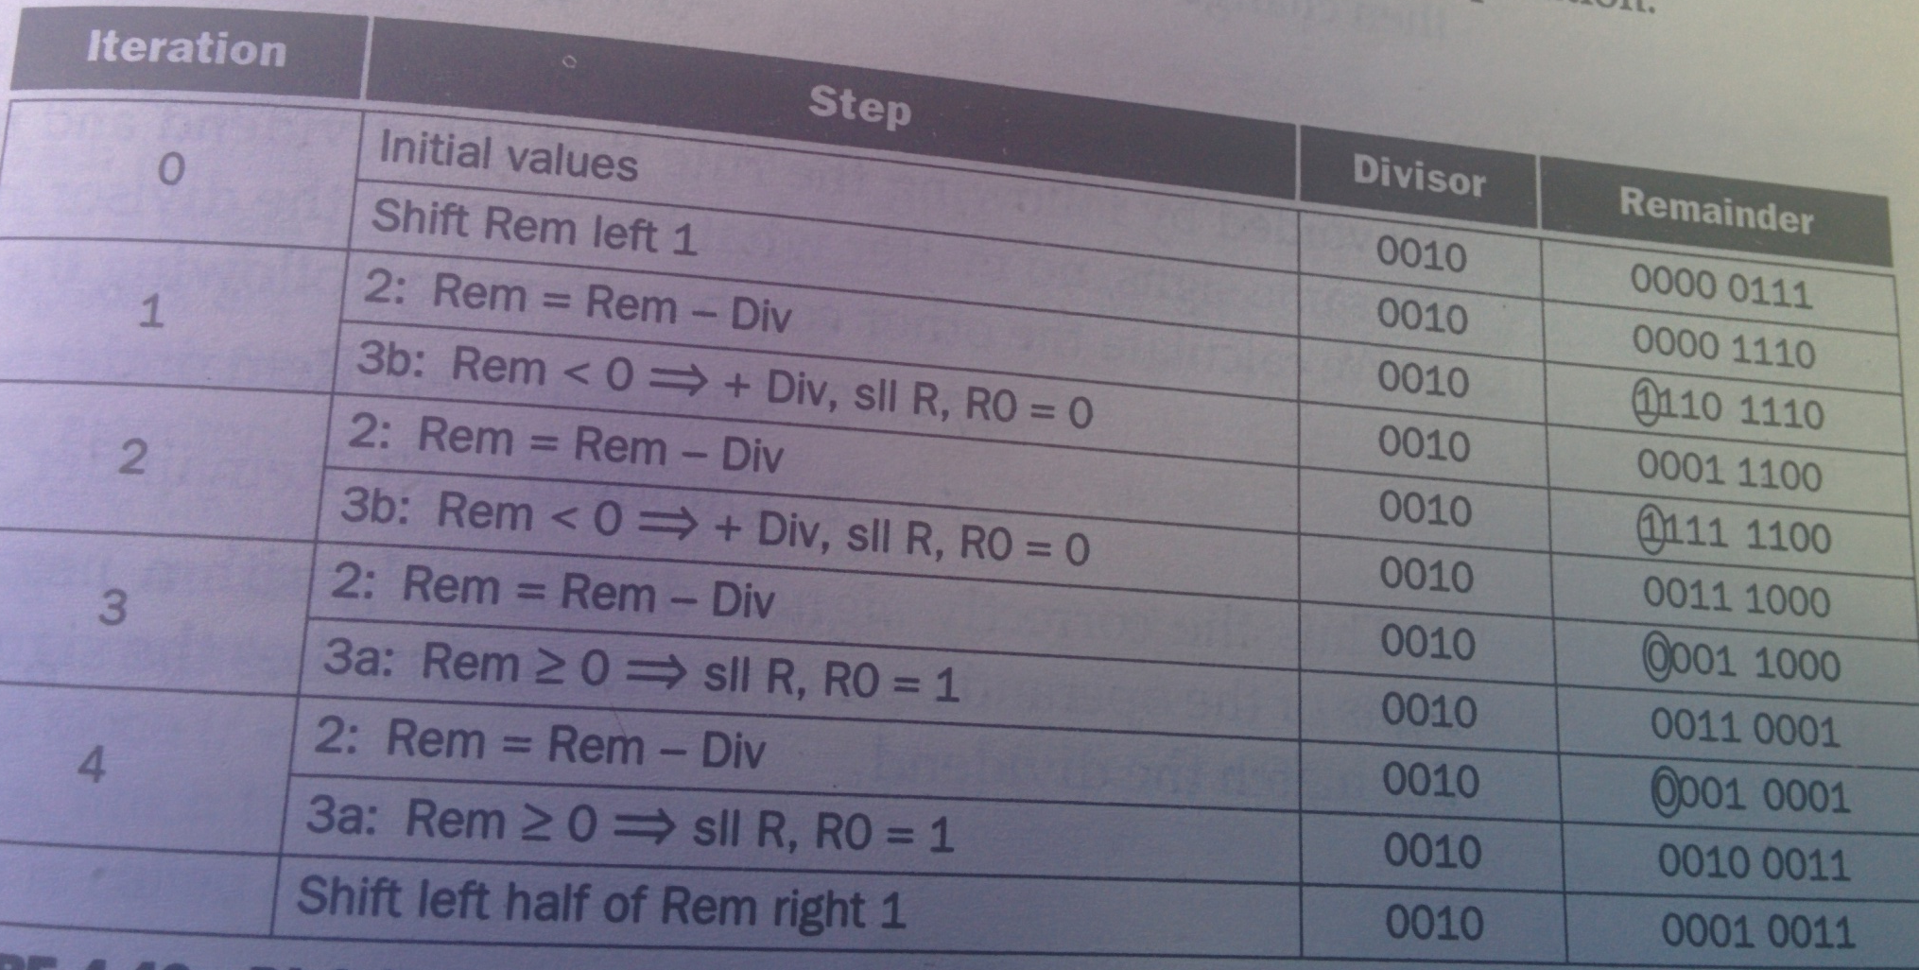
Example

Slide 42
Faster Division
Can’t use parallel hardware as in multiplier
Subtraction is conditional on sign of remainder
Faster dividers (e.g. SRT devision) generate multiple quotient bits per step
Still require multiple steps

